Slide 1
NeXUS is the frontier of ultrafast
attoseconds (10⁻¹⁸) discovered in 2001
attosecond is the natural time-scale of electrons in matter
attoseconds formed by amplitude and phase control of a XUV HHG comb
NeXUS XAS beamline has attosecond capability, typical value 200 as
as
150 as
as
as
n
as
10⁻¹⁸s
1 as
25 as
as
n
as
10⁻¹⁸s
1 as
time is defined by physical processes
Notes:
Optical pulses gave access to nuclear dynamics that occur on the femtosecond time-scale (click to expansion)
Natural time scale – Bohr atom - show limits of optical pulses
The XAS beamline/end station also has atto capabilities (amplitude and phase control)

Slide 2
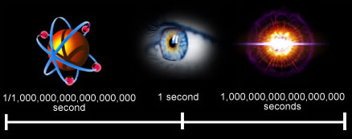
how short is an attosecond?
it is an absurdly small amount for time
it is as short, as the universe is old
it is the shortest time humans can produce
it is extreme time precision
Notes:
Let’s think of the precision

Slide 3
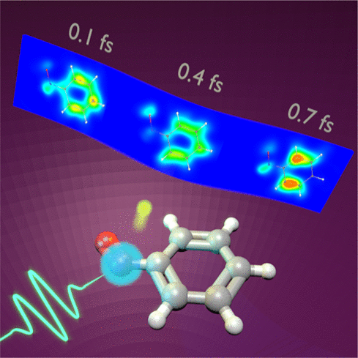
electronic response at early times
is there a time (phase) associated with electronic excitation?
how does correlation evolve and decohere with time?
charge migration is the coherent evolution of a hole driven by correlation and relaxation
relevant to charge transport which is primary in photochemistry
Cederbaum CPL 1999
Notes:
At early time, all electronic excitations should look similar and evolve in time, is this coherent?
How do the nuclear dynamics couple?
Is there a difference from excitation in the bulk and surface?
Second question could have relevance in quantum materials (click)
Example is charge migration in molecular systems (describe the creation of a localized hole)
nitrosobenzene

Slide 4
NeXUS planned operational model
NeXUS is an open NSF facility for the national user community
user access is awarded based on a competitive and transparent peer review process
NeXUS will have a professional staff to enable user experiments
NeXUS success depends on community participation
series of workshops highlighting technical capabilities while soliciting user input
establish a NeXUS executive user committee
an autonomous proposal review panel
spreading the word about NeXUS through talks and other media
Notes:
point 1: It operates like any large-scale light source facility except on smaller scale
How do we achieve this?

Slide 5
Institute for Optical Science (iOS)
established in 2018 by OR as an umbrella organization, user office
build, connect and educate a local community with interest in the optical sciences
organize responses to opportunities in emerging areas
Office of Research
iOS
community
education
connectivity
Notes:
How do we do this since NeXUS is an infrastructure project
At all levels on engagement from student to faculty, regional institutions and industrial
Pillars of iOS are community, connectivity and education
Ultrafast is one such areas and NeXUS is one excellent example

Slide 6
iOS building excellence in ultrafast science around NeXUS
Ultrafast leadership under iOS
enhancing NeXUS support
administration, workshops, user office
external collaborations via MOUs
NSF support for AccelNet proposal
Federal center proposals, i.e. NSF physics frontier center
development of a vision for the west campus research corridor
sponsor the OSU OSA student chapter
Office of Research
iOS
NeXUS
NSF PFC
MOU
OSA
NSF AccelNet
Notes:
How do we do this since NeXUS is an infrastructure project
iOS logistical
MOU with our two midscale counterparts in Michigan, ASU and international counterpart in Hungary (ELI-ALPS)
AccelNet is a program to build an international network of networks, in essence it is an exchange of personnel, ideas and technical resources. AccelNet will formally link the 3 extreme light mid-scales and 6 European network partners: Italy, Spain, Netherlands, Hungary, Czech Republic and Romania
We believe These efforts will make OSU the go to place in UF cience in the US

Slide 7
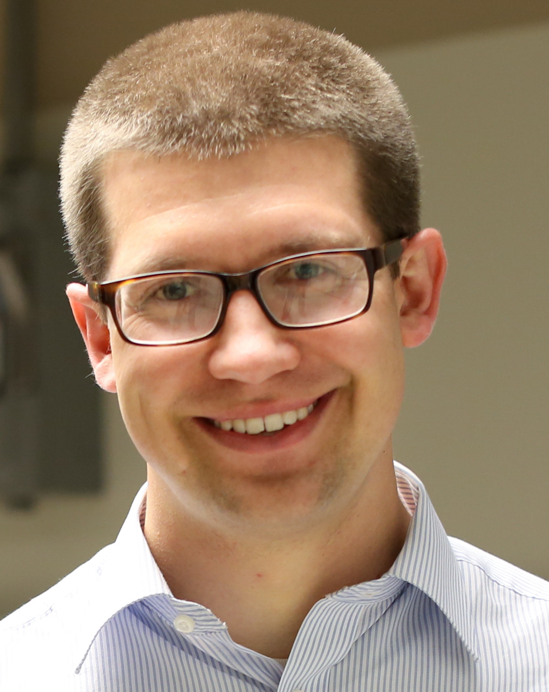
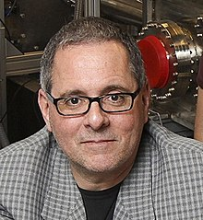
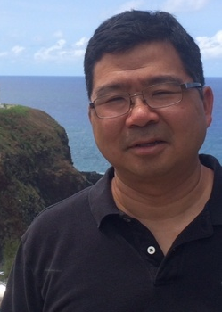
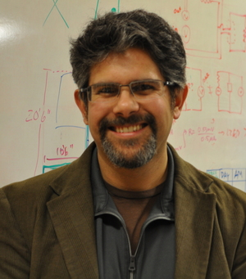
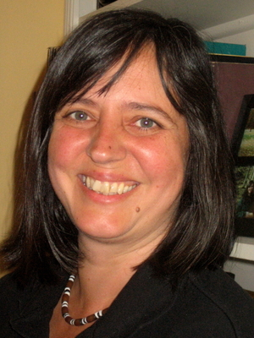
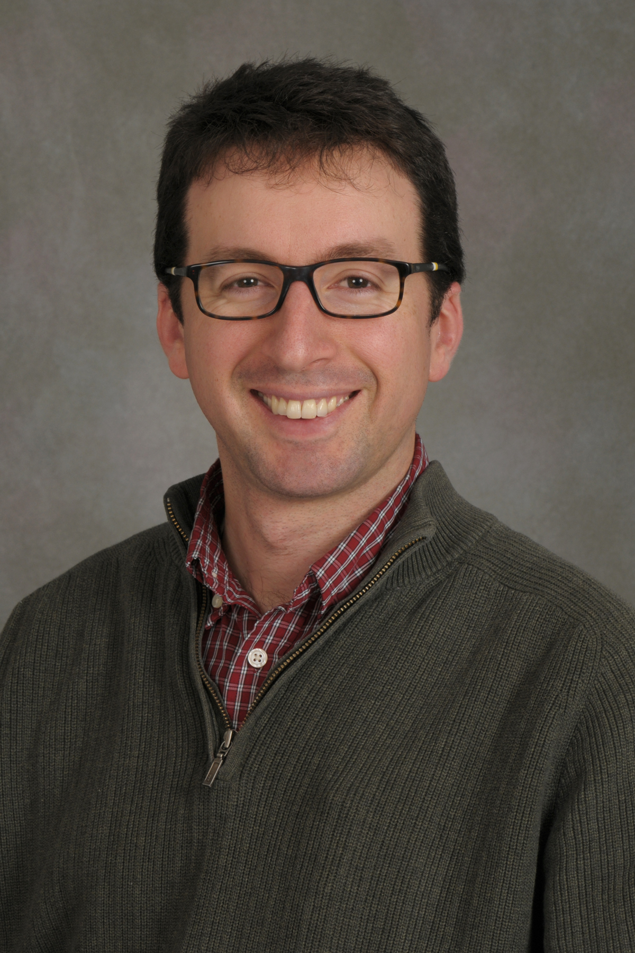
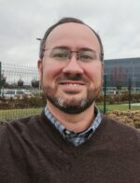
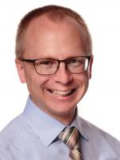
panel discussion
ATTO / LIED
TR-XAS/XRS
TR-XAS/XRS
TR-ARPES
TR-STM
TR-XAS/XRS
TR-ARPES
Robert Baker
Co-Director
Lou DiMauro
Co-Director
Roland
Kawakami
Jay Gupta
Claudia Turro
Tom Allison
Tim Scarborough
Facility Manager
TJ Ronningen
Project Manager
Jessi Middleton
Administrative

