Slide 1


NSF NeXUS and the Future of Ultrafast Optical Sciences
March 18, 2021

Slide 2

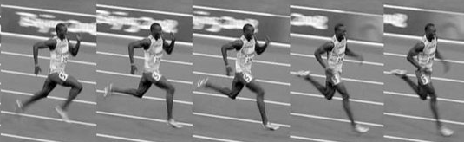
Resolving Ultrafast Motion
https://posemethod.com/usain-bolts-running-technique/

Slide 3
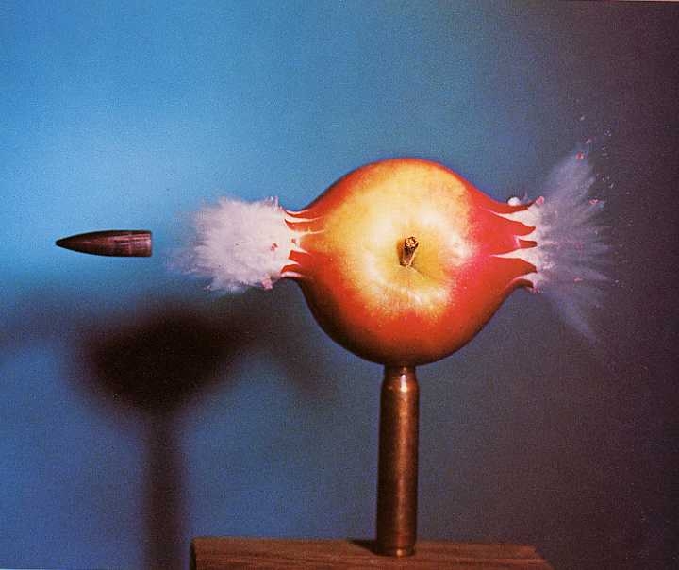
Resolving Ultrafast Motion
Mode-locked femtosecond laser pulses
s
ms
μs
ns
ps
fs
as
Harold Edgerton, MIT, 1964
μs-Photography
1
.001
.000 001
.000 000
001
.000 000
000 001
.000 000
000 000
001
.000 000
000 000
000 001
time

Slide 4
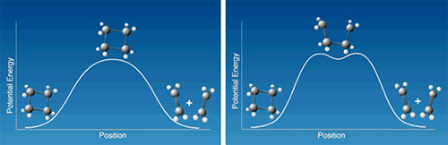
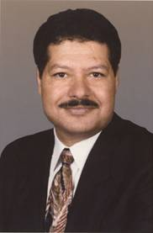
Resolving Ultrafast Motion
700 fs
Ahmed Zewail
Nobel Prize 1999
Pedersen, Herek, and Zewail, Science, 266, 1359 (1994)
Polanyi and Zewail, Acc. Chem. Res., 28, 119 (1995)

Slide 5
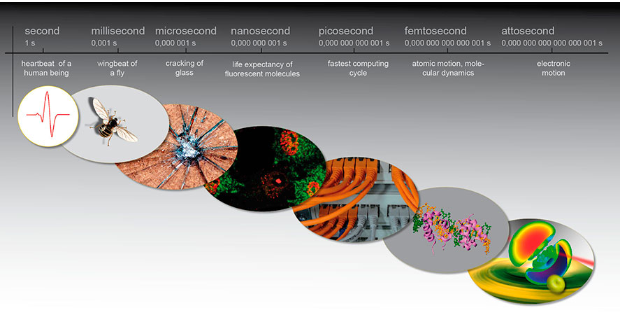
Resolving Ultrafast Motion
www.attoworld.de

Slide 6
Resolving Ultrafast Motion
What happens faster than a femtosecond?
  Absorption and photoionization
  Electronic coherences and quantum interference
  Exchange interactions and spin coupling
These processes control and set in motion
  Charge migration in molecules and materials
  Light harvesting and energy conversion
  Ultrafast spin and magnetization switching

Slide 7
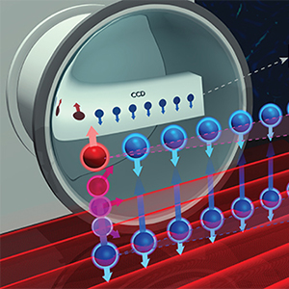
NSF NeXUS Scientific Vision
Observe, manipulate, and control the behavior of particles and energy at atomic and sub-atomic scales
Quantum Leap
One of NSF’s 10 Big Ideas

Slide 8

NSF NeXUS Scientific Vision
The grand challenges of today will not be solved by one discipline alone. They require convergence: the merging of ideas from widely diverse fields.
Growing Convergence Research
One of NSF’s 10 Big Ideas

Slide 9

NSF NeXUS Scientific Vision
“[Mid-scale] projects include an impressive collection of new design efforts and advanced instrumentation. These projects fill gaps and provide unique research capabilities for the U.S.”
–Jim Ulvestad, NSF
Mid-Scale Research Infrastructure
One of NSF’s 10 Big Ideas

Slide 10
NSF Midscale Projects
2019 was inaugural year for NSF Midscale Infrastructure program
Out of 254 proposals, NSF made 10 awards (funding rate <4%)
  3 Infrastructure design projects
  7 Implementation projects
  2 of these 7 were awarded to Ohio State
    National eXtreme Ultrafast Science Facility
    Gateway Ultrahigh Field NMR (Rafael Bruschweiler)

Slide 11
NSF Midscale Projects
NeXUS (CHE)
Next Generation Event Horizon Telescope – Design only (AST)
Wyoming King Air Atmospheric Research Aircraft (AGS)
Gateway Ultrahigh Field NMR (DBI)
Gravitation Wave Detection CMB-S4 – Design only (OPP)
Compact X-Ray Free Electron Laser – Design only (DBI)
Neutron Spin Echo Spectrometer (DMR)
FABRIC Computer Networking Infrastructure (CNS)
Zettawatt Equivalent Ultrashort Pulse Laser (PHY)
Software-Defined Sensor Network (OAC)
NSF Chemistry Director, David Berkowitz, refers to NeXUS as a “centerpiece of NSF Chemistry”

Slide 12
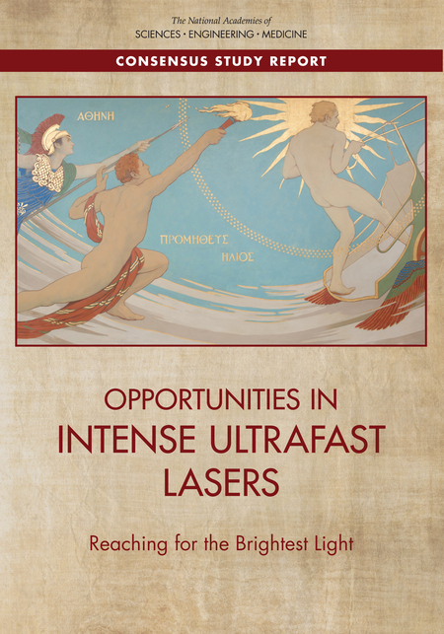
Mid-scale Program Directly Addresses NAS Recommendations for US Laser Infrastructure
“The United States was the leading innovator and dominant user of high-intensity laser technology when it was developed in the 1990s, but Europe and Asia have now grown to dominate this sector through coordinated national and regional research and infrastructure programs. In Europe, this has stimulated the emergence of the Extreme Light Infrastructure (ELI) program.”
Opportunities in Intense Ultrafast Lasers: Reaching for the Brightest Light, NAS, 2018

Slide 13
NSF NeXUS Bridging Light Sources
NSF NeXUS

Slide 14
NSF NeXUS Bridging Light Sources
10¹⁷
X-Ray Free Electron Lasers
10¹⁴
Synchrotrons
10¹¹
NSF NeXUS
Photons / sec / 0.1% Bandwidth
10⁸
Existing High
Harmonic Generation
10⁵
10 as
1 fs
100 fs
10 ps
1 ns
Time Resolution

Slide 15
The NeXUS Facility
At the heart of NeXUS is a new technology in kilowatt-class ultrafast lasers
This technology was recently developed in Europe in response to the Extreme Light Infrastructure (ELI) project
NeXUS will be the first facility to translate this technology to the US
The NeXUS laser will produce:
  8 mJ at 100 kHz or
  0.8 mJ at 1 MHz
  Pulse duration down to 8 fs
Drive attosecond and femtosecond XUV and soft X-ray generation

Slide 16
Transformation in User Science at NeXUS
Why high repetition rates?
Enabling a quantum leap in sample throughput
Current State-of-the-Art:
HHG with Ti:Sapphire laser
Repetition rate: 1 kHz
Required sample averaging: >10 h per sample
NeXUS Facility:
HHG with kW-class laser
Repetition rate: 100 kHz
Required sample averaging: <10 min per sample
This increase in make experiments possible at NeXUS that currently cannot be performed anywhere else in the world

Slide 17
NeXUS Project Timeline
NeXUS is a 5-year implementation project (2019–2024)
Years 1-3:
  Lab renovation and site preparation
  Acquisition of laser and other major equipment
  Beamline and end-station design and construction
Years 4-5:
  System integration
  Science validation – First users
  Transition to operations
Year 5 and beyond:
  Operation and maintenance
5-year project
First Users
Open Access
FY20 FY21 FY22
FY23 FY24
reno, design, construction, commissioning
integration & science validation

Slide 18
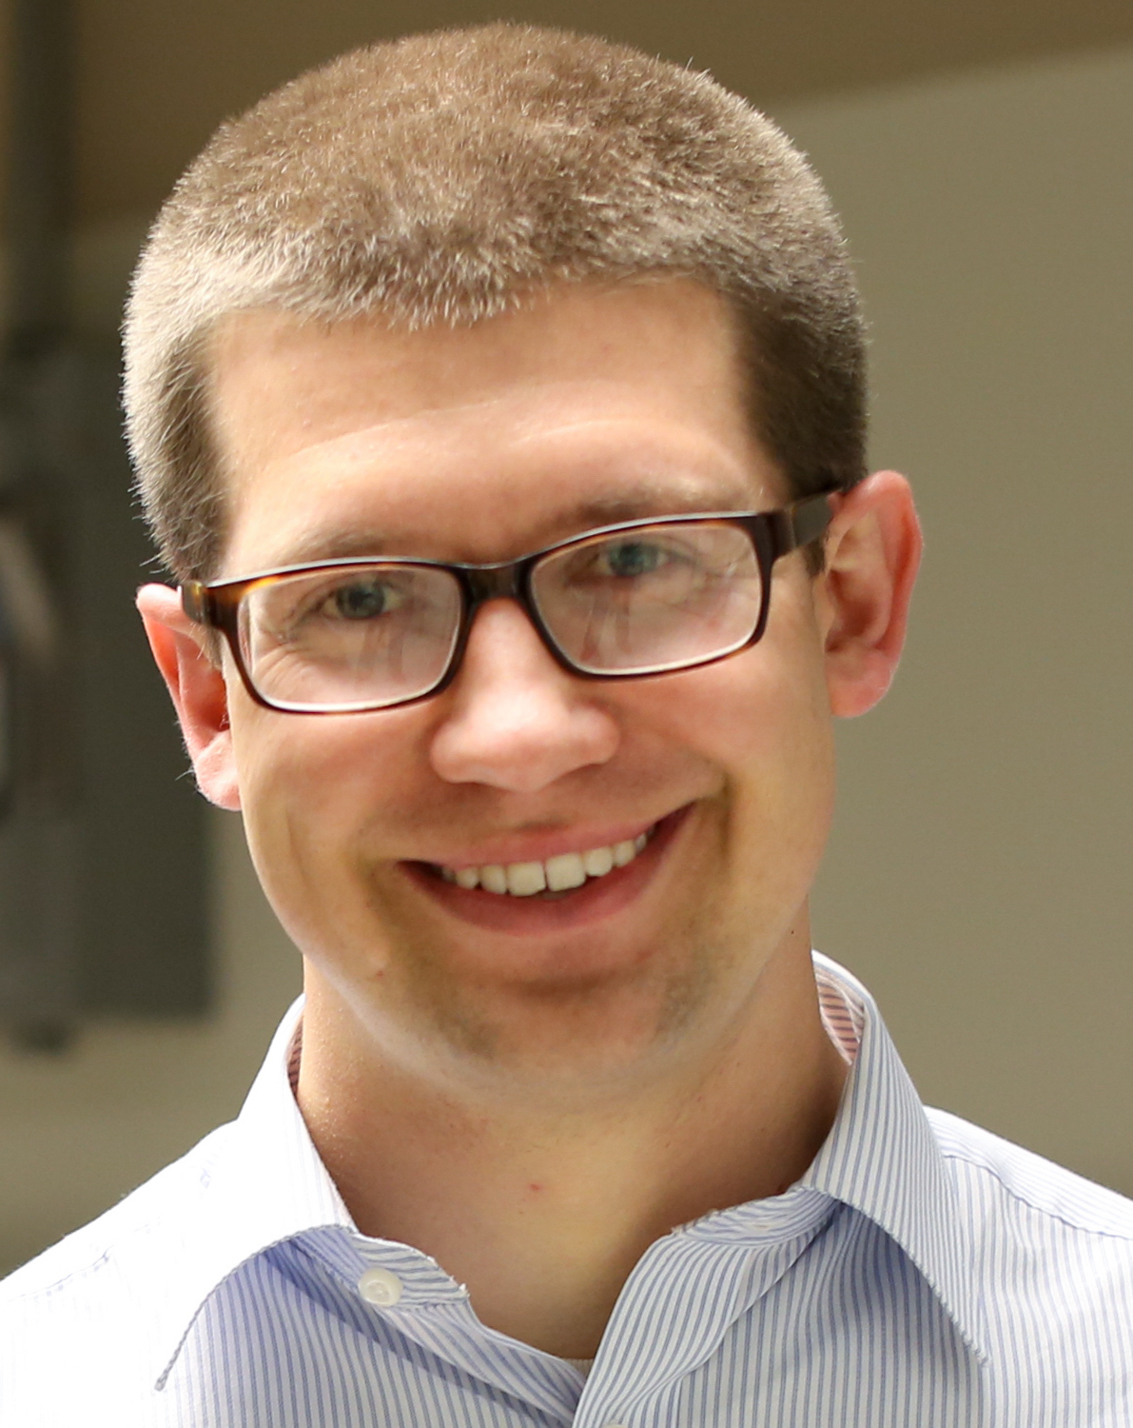
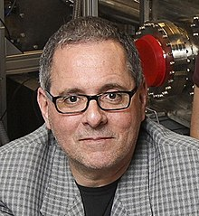
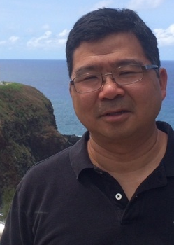
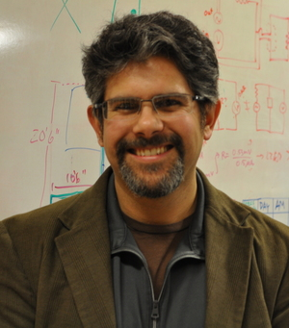
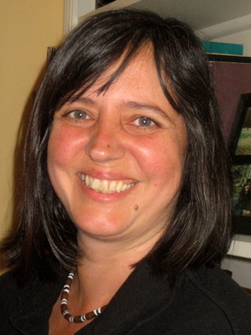
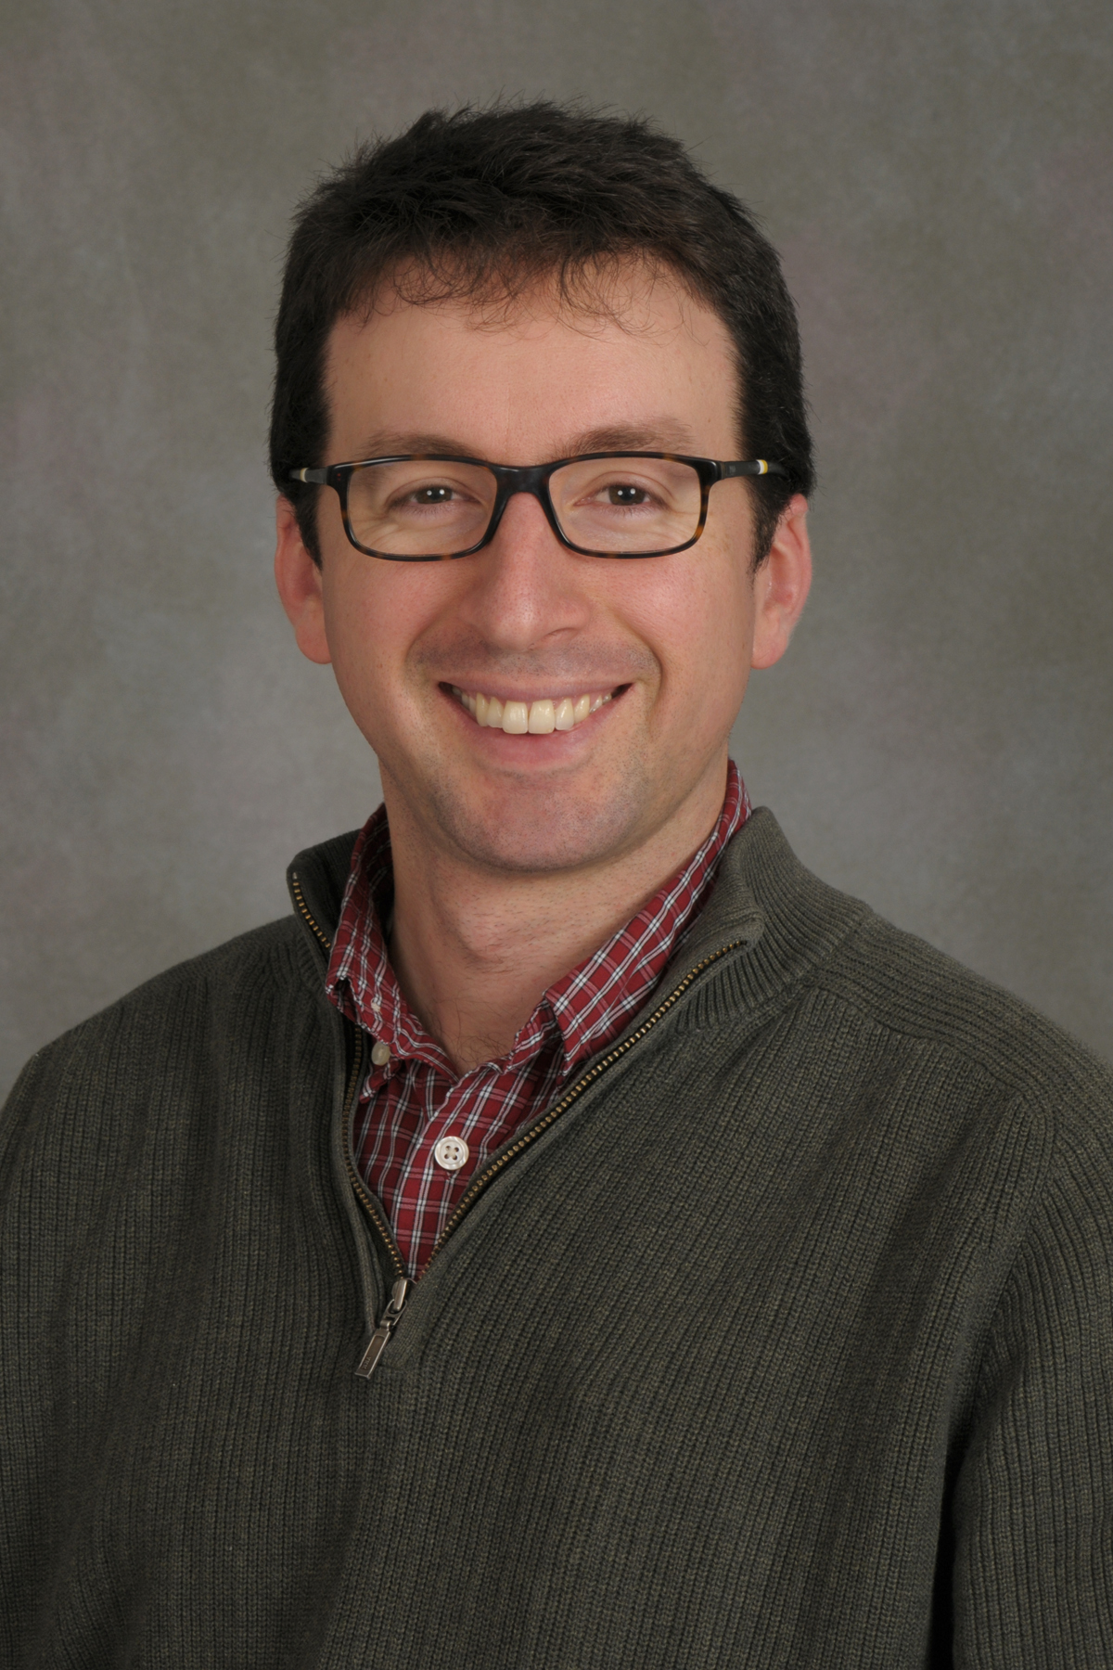
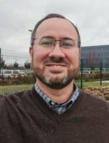
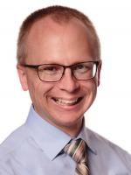

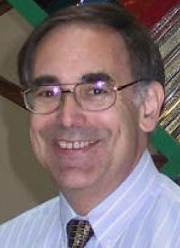
The NeXUS Team
ATTO / LIED
TR-XAS/XRS
TR-XAS/XRS
TR-ARPES
TR-STM
TR-XAS/XRS
TR-ARPES
Robert Baker
Co-Director
Lou DiMauro
Co-Director
Roland
Kawakami
Jay Gupta
Claudia Turro
Tom Allison
Tim Scarborough
Facility Manager
TJ Ronningen
Project Manager
Jessi Middleton
Administrative
Kelsey Cook
NSF Program Officer

Slide 19
The NeXUS Team
Claudia Turro (Chair of Chemistry & Biochemistry, NeXUS co-PI)
NeXUS user applications in molecular magnetism, molecular qubits
Impact of NeXUS on the chemistry of quantum information science, photochemotherapy and energy conversion

Slide 20
The NeXUS Team
Roland Kawakami (Physics Department, NeXUS co-PI)
NeXUS user applications in condensed matter physics, ultrafast magnetisms, and topological states of matter
Impact of NeXUS on the materials research community

Slide 21
The NeXUS Team
Lou DiMauro (Physics, NeXUS co-Director, iOS Director)
Outlook on the future of ultrafast optical science
Building a community around optical sciences at Ohio State University

